Slide 1


iOS Mobile App Development Internship Report
This presentation summarizes my internship experience in iOS mobile app development, highlighting key learnings, challenges, and future aspirations.
by Suraj Upadhye

Slide 2
Internship Overview
Program Details
Key Objectives
The internship was conducted at Walchand College of Engineering, Sangli, under the Apple Authorized Training Center for Education (AATCe). It provided industry-standard training led by Apple Certified Trainers.
The primary goal was to build a strong foundation in iOS development, ensuring participants gained expertise in Swift programming, Xcode, and UIKit.

Slide 3
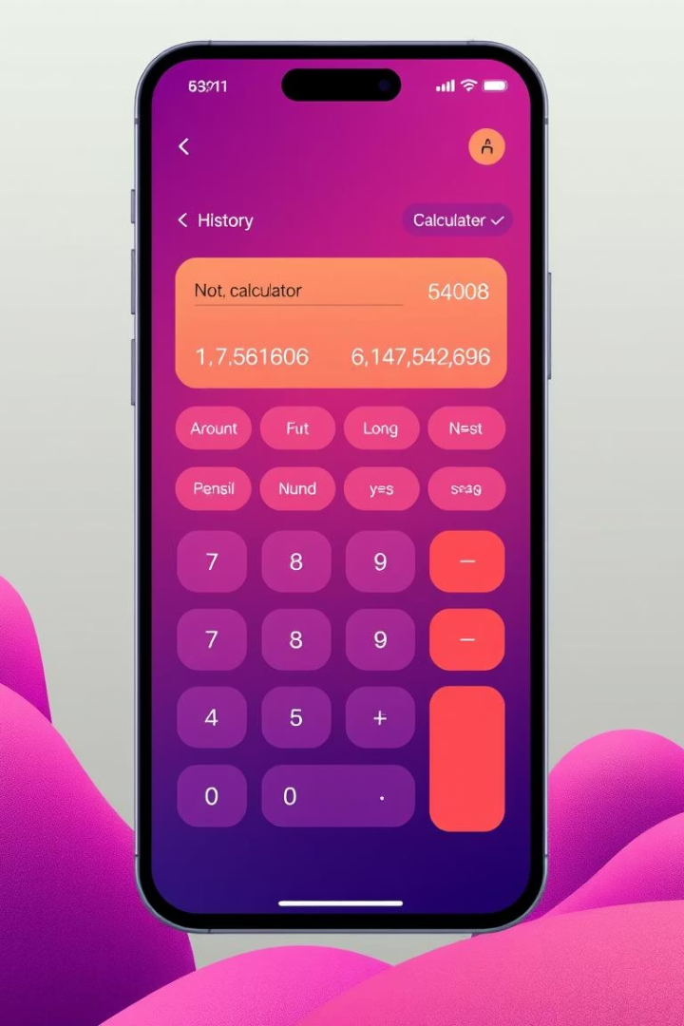
Internship Work Description
Project Title
Simple Calculator App with History
Responsibilities
Designing the UI
Implementing Arithmetic Operations
File Handling for History
Developing Multiple Views
Clearing History
Debugging and Testing

Slide 4





Tools and Technologies
Swift
Xcode
UIKit
Auto Layout
The internship involved using a variety of tools and technologies, including Swift, Xcode, UIKit, Auto Layout, FileManager, Navigation Controller, Tab Bar Controller, and Storyboard Segue.

Slide 5
Challenges Faced
1
Handling Swift's Optionals
2
Implementing Auto Layout for a Responsive UI
3
Managing Navigation Between Screens
Understanding optionals and using safe unwrapping techniques to avoid runtime crashes.
Designing a UI that adjusted seamlessly across different screen sizes using Stack Views and Auto Layout.
Passing data between different view controllers using prepare(for:sender:) to ensure smooth transitions.
4
Storing and Retrieving Calculation History
5
Debugging Errors in Xcode
Implementing FileManager to store and retrieve calculation history in a structured format.
Using breakpoints, console logs, and Xcode's debugger to systematically track and fix errors.

Slide 6



Learning Outcomes
Technical Skills
1
Gained proficiency in Swift programming, Xcode, UIKit, File Handling, Auto Layout, and debugging techniques.
Soft Skills
2
Developed problem-solving, time management, teamwork, adaptability, and communication skills.
Certifications
3
Successfully completed the internship under the Apple Authorized Training Center for Education (AATCe).

Slide 7





Future Scope
Advanced iOS Development
Exploring SwiftUI for building declarative and modern UI designs, API integration, Core Data & Cloud Storage.
Enhancing the Calculator App
Adding scientific calculator features, dark mode & themes, and cloud syncing.
Expanding to Full-Stack Development
Learning backend development with Node.js, Firebase, or other backend services, and implementing real-time data processing.
Career & Certification Opportunities
Preparing for Apple Developer Certification, exploring internship and job opportunities, and developing and publishing personal iOS apps.

Slide 8

Key Takeaways
This internship provided a valuable learning experience, equipping me with the necessary skills and knowledge to pursue a career in iOS development. I gained a deep understanding of Swift programming, Xcode, and UIKit, and I am confident in my ability to design and develop functional iOS applications.

Slide 9
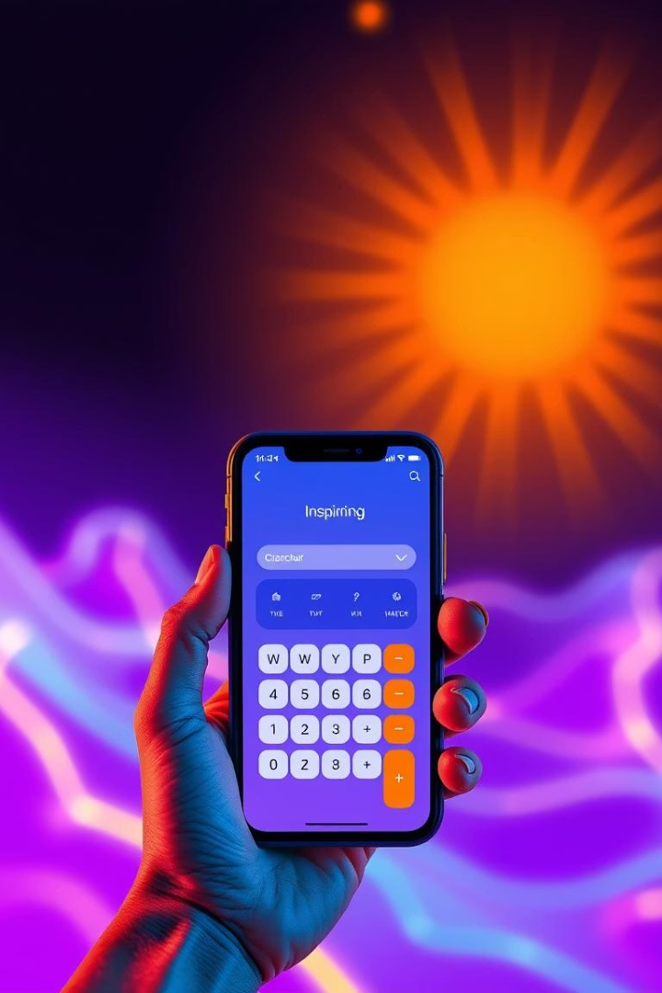
Next Steps
I plan to continue learning and developing my skills in iOS development by exploring advanced topics like SwiftUI, API integration, and backend development. I am also eager to pursue internship and job opportunities in the field and to develop and publish my own iOS apps on the App Store.

